Slide 1
Deep Graph Library an update
https:www.dgl.ai
Zheng Zhang
Director, AWS Shanghai AI Lab (zhaz@amazon.com)
zz@nyu.edu (on leave)

Slide 2
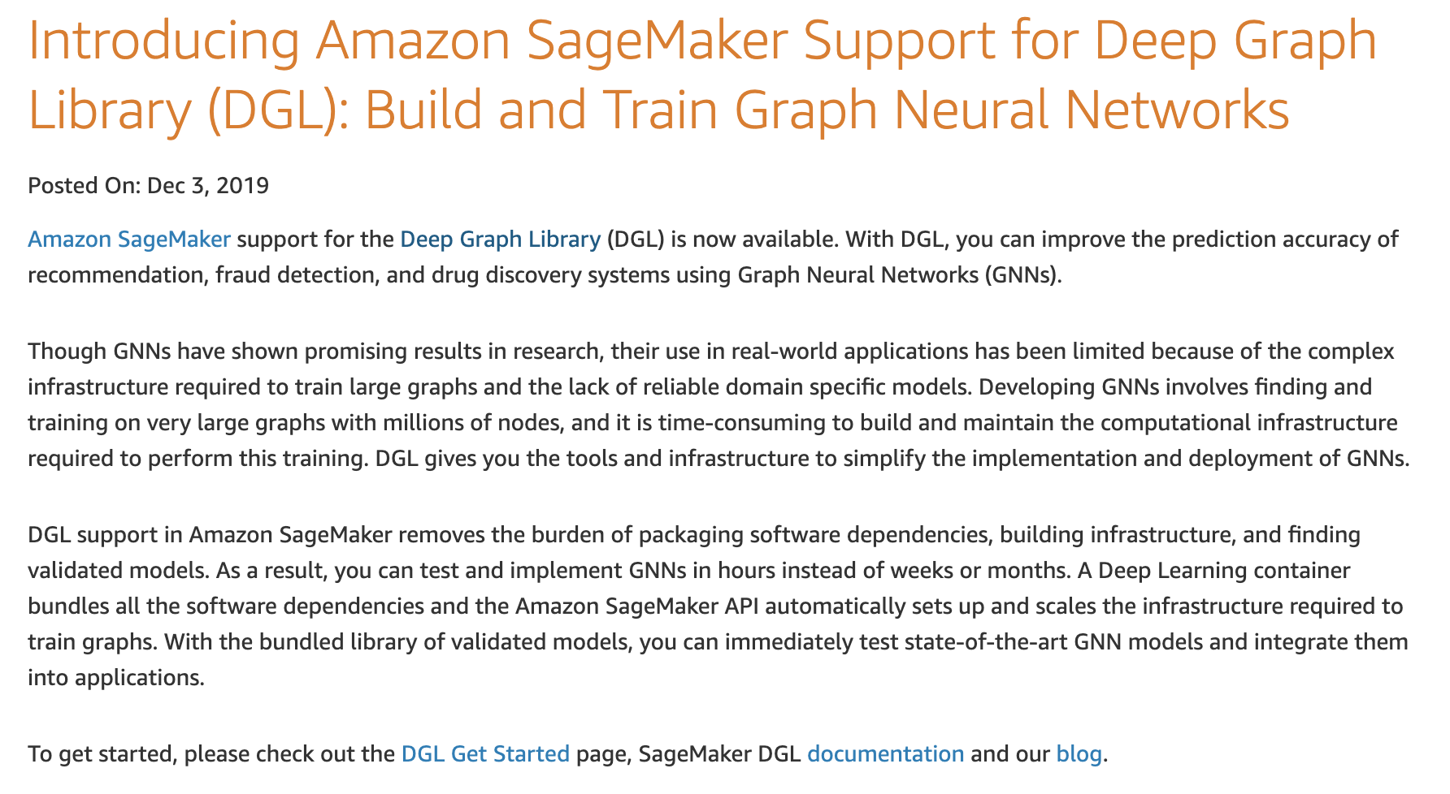
DGL: The history
V0.3.1
NN modules
DGL-Chem
Development started
V0.2
Sampling APIs
2018
2019
2020
V0.3
Fused message passing
Multi-GPU/-core
First prototype
V0.1
(NeurIPS’18)
V0.4
Heterogeneous graph
DGL-KE

Slide 3
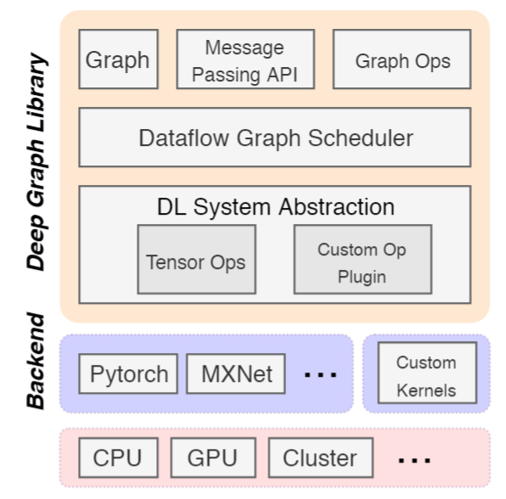
DGL meta-objective & architecture
Forward and backward compatible
Forward: easy to develop new models
Backward: seamless integration with existing frameworks (MXNet/Pytorch/Tensorflow)
Fast and Scalable

Slide 4
DGL: design & API

Slide 5
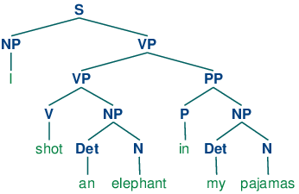
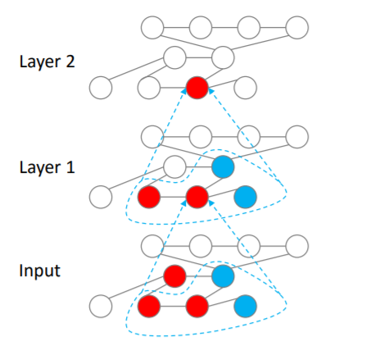
Flexible message propagation
Full propagation (“everyone shouts to everyone near you”)
Propagation by graph traversal
Topological order on sentence parsing tree
Belief propagation order
Sampling
Propagation by random walk

Slide 6
Flexible message handling
Message function
Update function
Reduce function
[Gilmer 2017, Wang 2017, Battaglia 2018]

Slide 7
DGL programming interface
Graph as the core abstraction
DGLGraph
g.ndata[‘h’]
Simple but versatile message passing APIs
Active set specifies which nodes/edges to trigger the computation on.
can be user-defined functions (UDFs) or built-in symbolic functions.

Slide 8
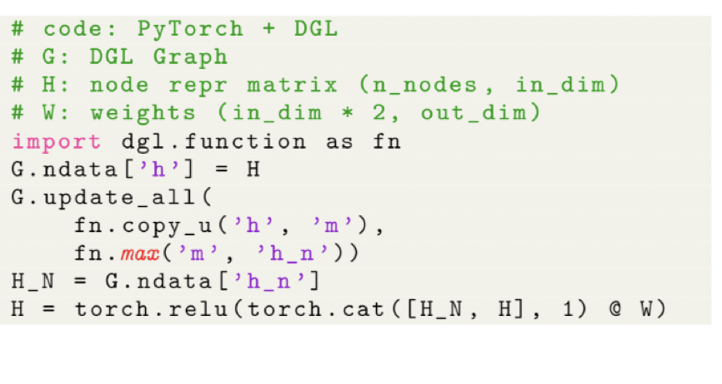
Writing GNNs is intuitive in DGL
update_all is a shortcut for send(G.edges()) + recv(G.nodes())

Slide 9
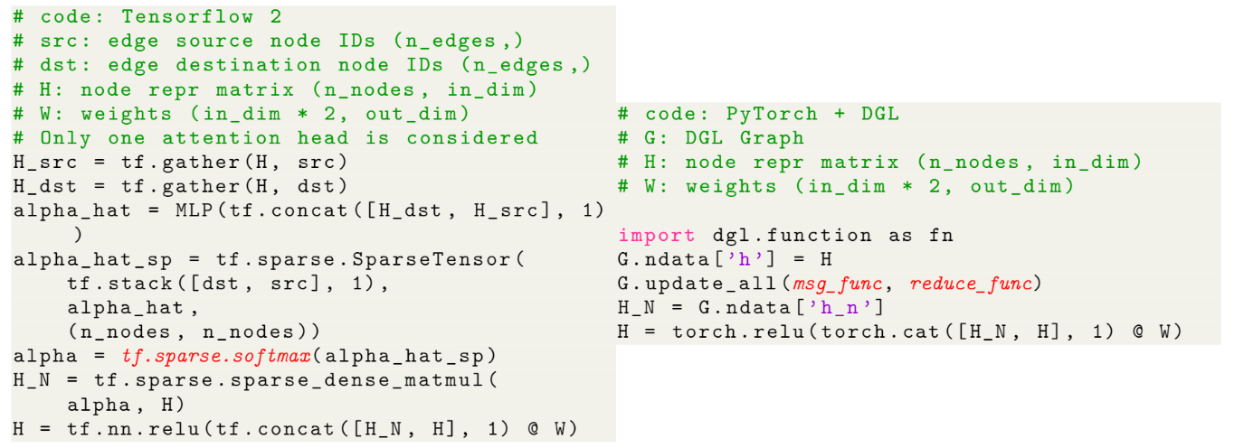
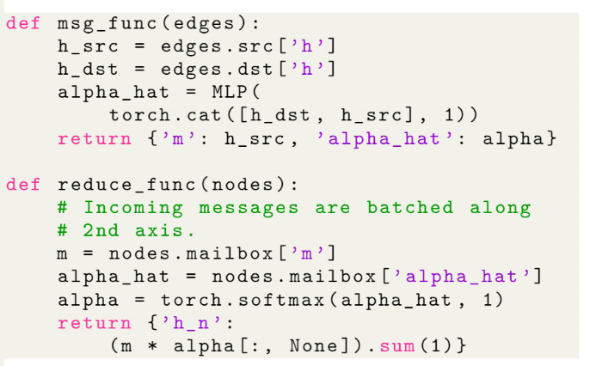
Writing GNNs is intuitive in DGL (GAT)

Slide 10
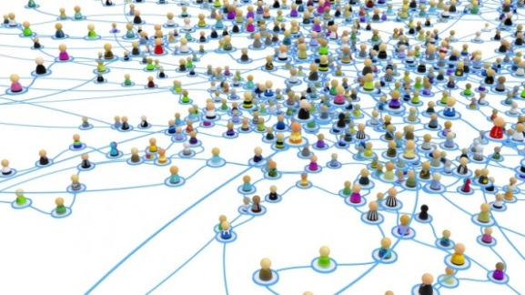
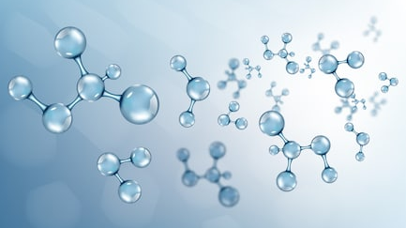
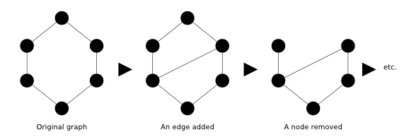
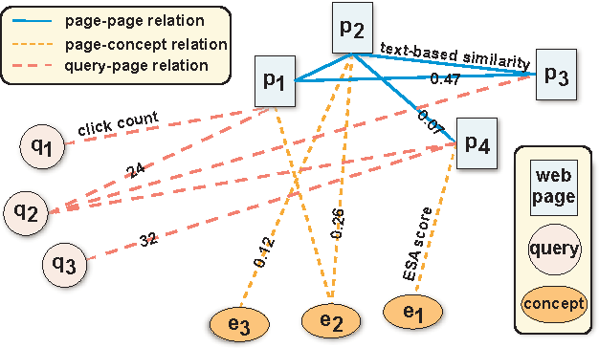
Different scenarios require different supports
Sampling
Batching graphs
Single giant graph
Many moderate-sized graphs
Mutation
Heterogeneous
Dynamic graph
Heterogeneous graph
Notes:
Another design consideration is that graphs in different scenarios require different supports
Community detection: system needs to be memory efficient, and support random walk and graph sampling
Drug discovery, protein property prediction: batching is a high priority
The system should support graph mutation
For example, this graph here represents the interactions in a search engine. A task could be given a query, what is the page returned? This can be casted as a link prediction problem on this graph.

Slide 11
Summary of DGL Programming Interface
User-defined functions
Send, Recv
Active set
Batching APIs
Mutation APIs
Sampling APIs
Support multi-type

Slide 12
Performance evaluation

Slide 13
Initially paid a price for multi-backend (woops!)
Fast Graph Representation Learning with PyTorch Geometric

Slide 14
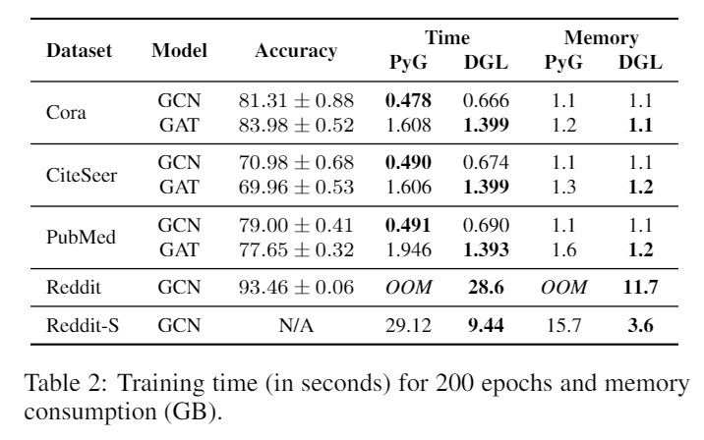
Evaluation: efficiency and memory consumption
Testbed: one V100 GPU (16GB)

Slide 15
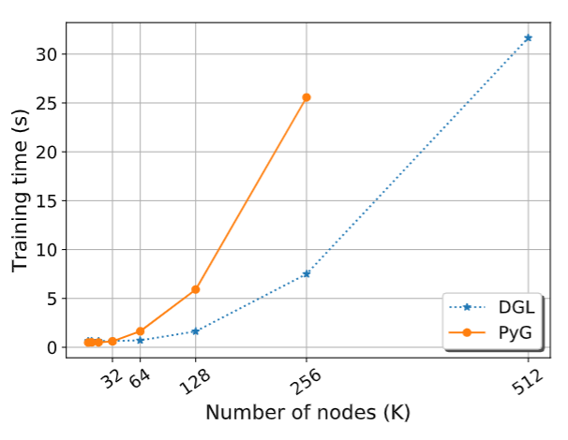
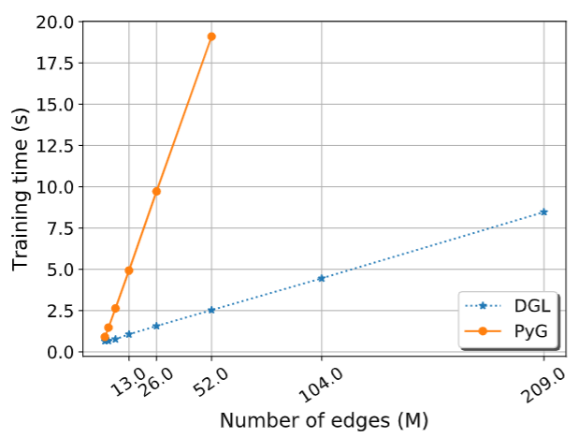
Scalability: single machine, single GPU
3.4x
7.5x
PyG: pytorch-geometric
Scalability with graph size
Scalability with graph density

Slide 16
Scalability: single machine, NUMA
X1, 2TB, 128 vCPU
Data set: Reddit (232K nodes, 114M edges)
Controlled-variate sampling

Slide 17
Scalability: single machine, multi-GPU
p3.16xlarge, 8 V100 GPUs, 64 vCPU
Data set: Reddit (232K nodes, 114M edges)
GraphSage neighbor sampling

Slide 18
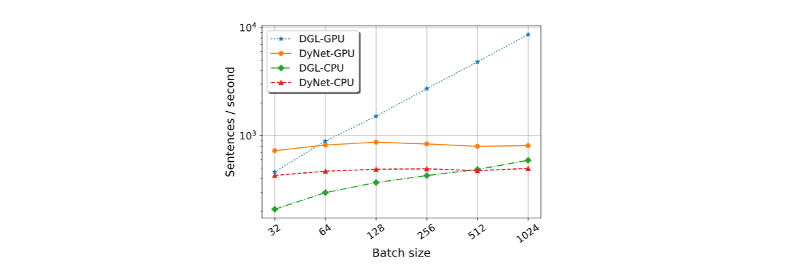
Evaluation: auto-batching
10.6x
Compare with DyNet for training TreeLSTM
Testbed: one V100 GPU (16GB)

Slide 19
What’s new

Slide 20
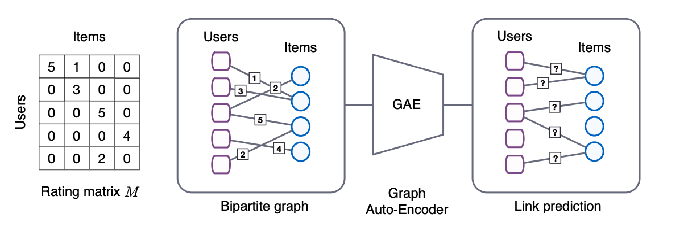
Heterogenous graph
Example: recommendation system, GCMC
Graph Convolutional Matrix Completion

Slide 21
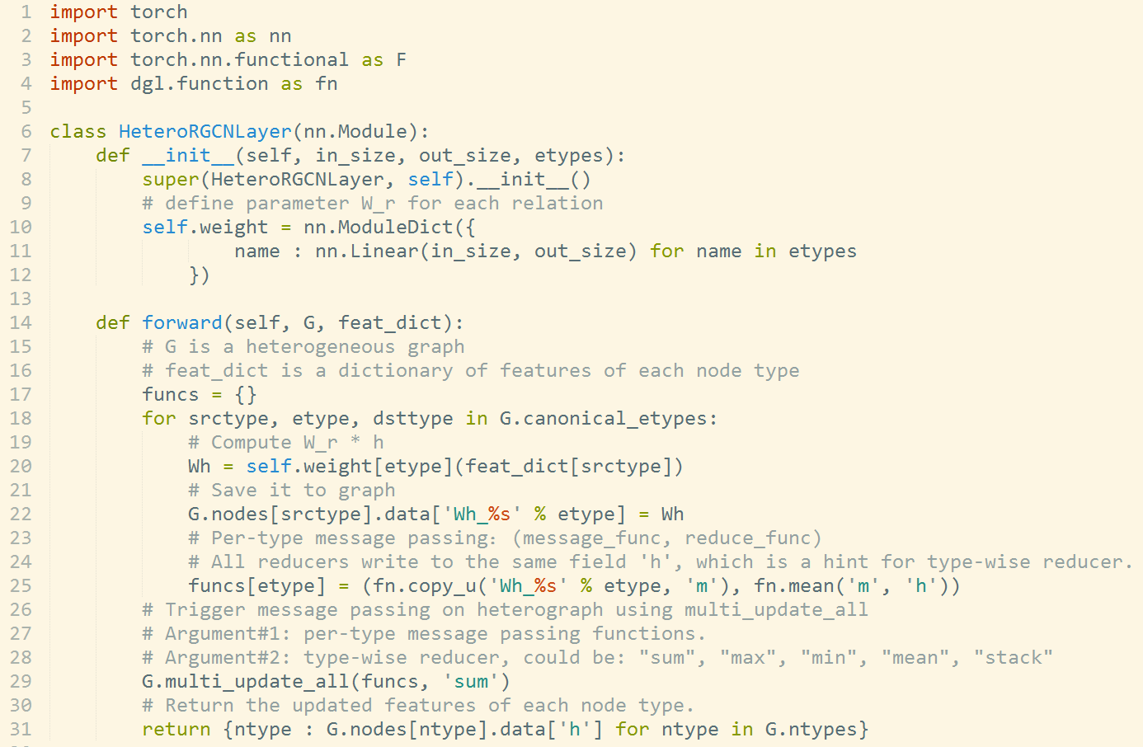
Supporting Heterogeneous Graph

Slide 22
Example: graph convolutional matrix completion
*Official training on MovieLens-10M has to be in mini-batch, which lasts for over 24+ hours
Dataset | RMSE (DGL) | RMSE (Official) | Speed (DGL) | Speed (Official) | Speedup
MovieLens-100K | 0.9077 | 0.910 | 0.0246 s/epoch | 0.1008 s/epoch | 5x
MovieLens-1M | 0.8377 | 0.832 | 0.0695 s/epoch | 1.538 s/epoch | 22x
MovieLens-10M | 0.7875 | 0.777* | 0.6480 s/epoch | Long*

Slide 23
Example: drug discovery
Training time per epoch (1 V100 GPU)
 | DGL | Official | Speedup
ACNN | 0.36 | 1.58 | 4.4x
Atomic Convolutional Neural Network (ACNN)

Slide 24
Digress: even more examples of drug discovery
Training time per epoch (1 V100 GPU)
 | DGL | Official | Speedup
ACNN | 0.36 | 1.58 | 4.4x
JTNN | 743 | 1826 | 2.5x
GCN (Tox21) | 1.9 | 8.4 | 4.4x
AttentiveFP* | 1.2 | 6.0 | 5x
*Pushing the Boundaries of Molecular Representation for Drug Discovery with the Graph Attention Mechanism (GAT, deep, GRU aggregation)

Slide 25
Multi-GPU training: knowledge graph
FB15K (15K nodes, 592K edges); on p3.8xlarge instance, up to 4 V100 GPUs

Slide 26
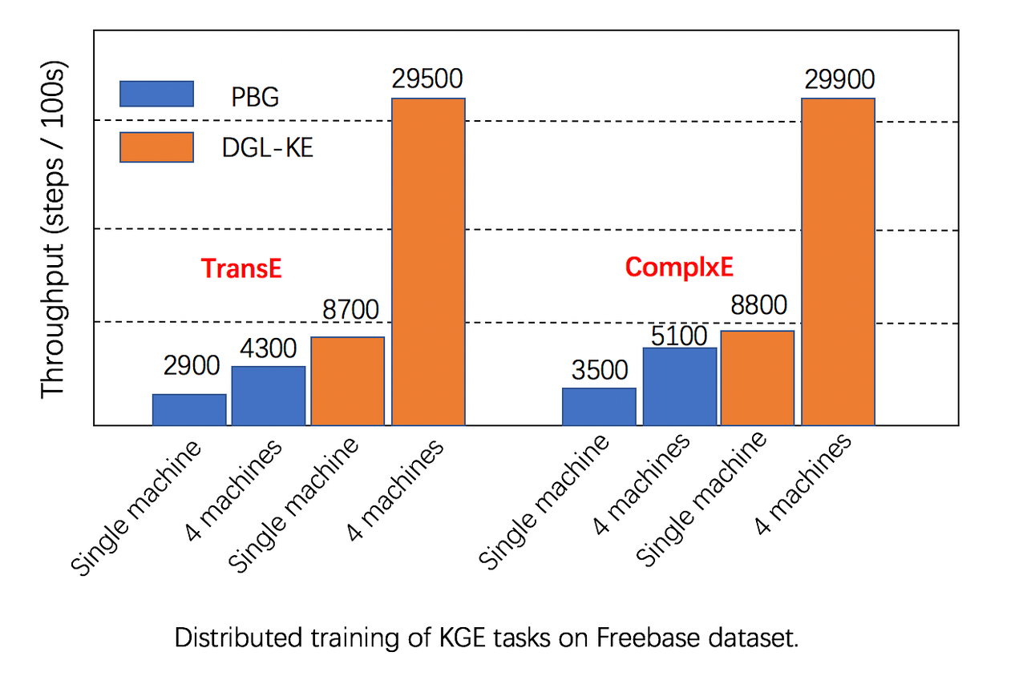
Distributed training: knowledge graph
Full Freebase (86M nodes, 338M edges)
Testbed: x1.32xlarge instance, 128 vCPU, 2TB RAM

Slide 27
Distributed training: GCN (preliminary results)
Neighbor sampling
Data set: Reddit (232K nodes, 114M edges)
Testbed: c5n.18x, 100Gb/s network, 72vCPU

Slide 28
TF backend (experimental)
Vanilla TF (TF 1.0)
DGL + TF (TF 2.0)

Slide 29
Seeing the world from the lens of graphs
Small graphs produced every second (e.g. sentences and images)
log(# Graphs created/second)
Strong AI
Several giant graphs changes every second
(e.g. knowledge graph, social networks)
log(Graph size)

Slide 30
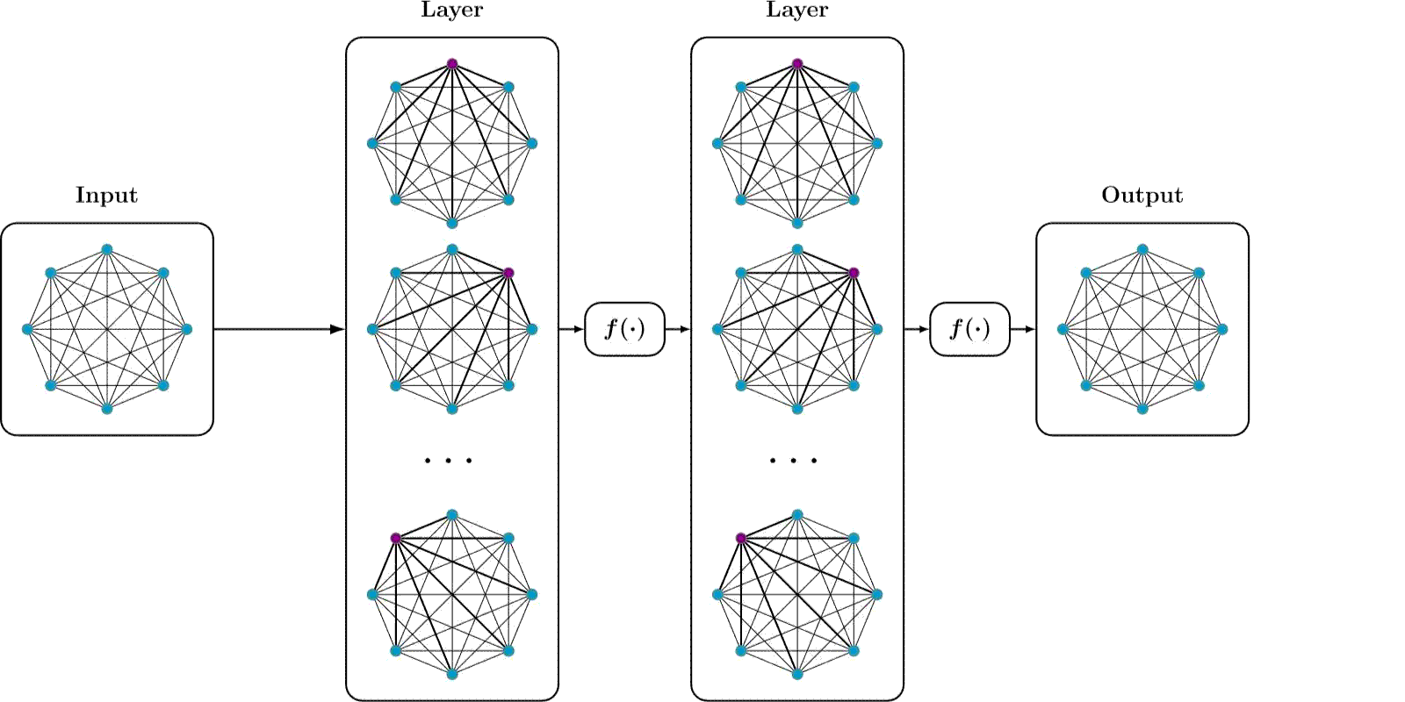
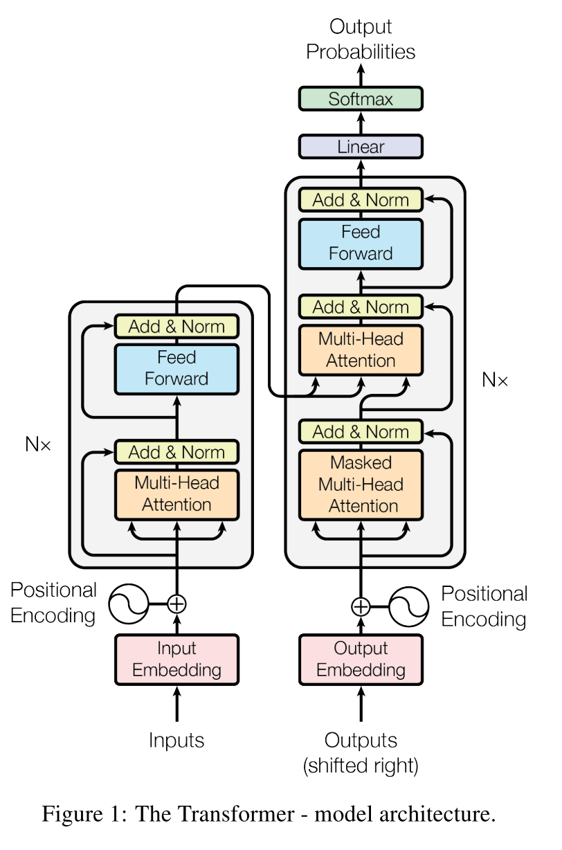
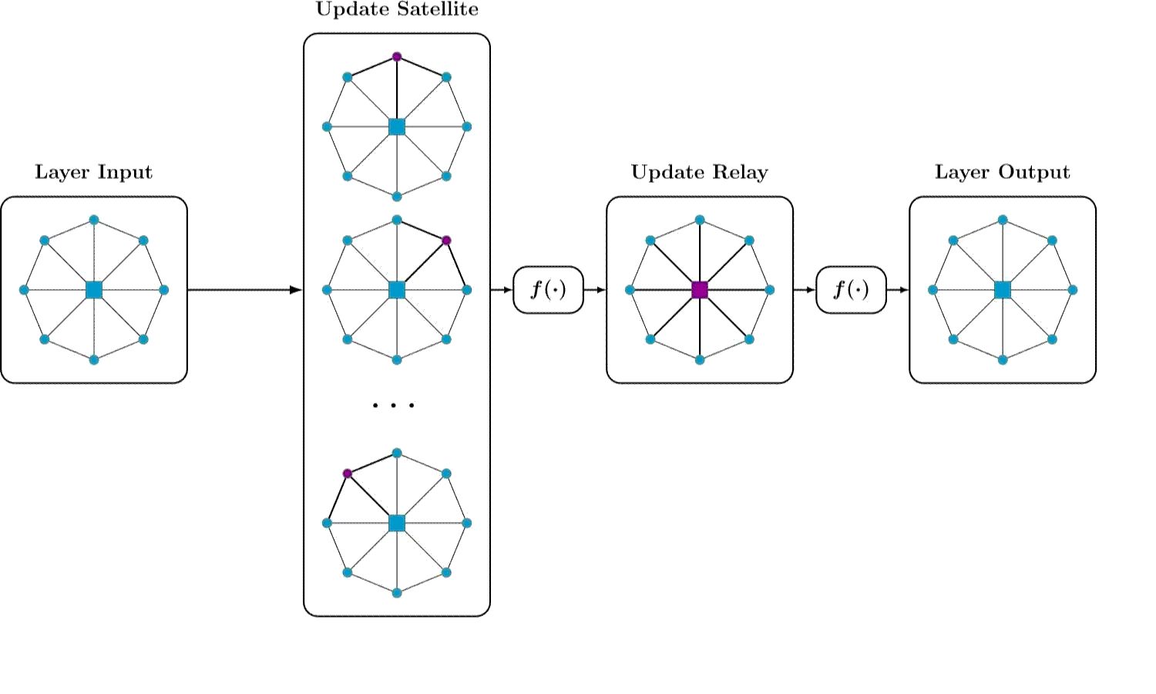
Transfomer is GAT (over a complete graph)
Transformer:
- $O(n^{2})$: data hungry
Star-Transformer (in NAACL’19)
$O(n)$: much less data hungry
Leverages ngram prior, but has issues with long dependency
SegTree-Transformer (in ICLR’19 RLGM)
$O(nlog n )$: less data hungry
A good compromise in between

Slide 31
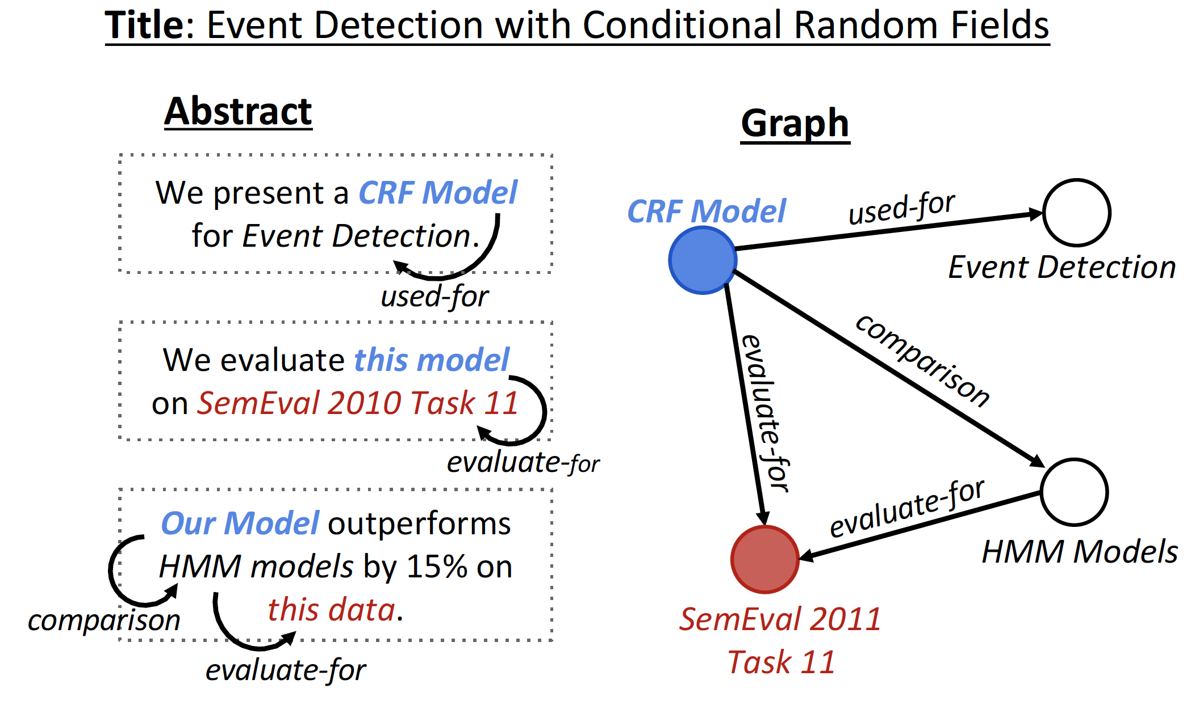
Graph in Natural Language Processing
Knowledge Graph to Sentence
Input: a title and knowledge graph
Output: abstract
Text Generation from Knowledge Graphs with Graph Transformers

Slide 32
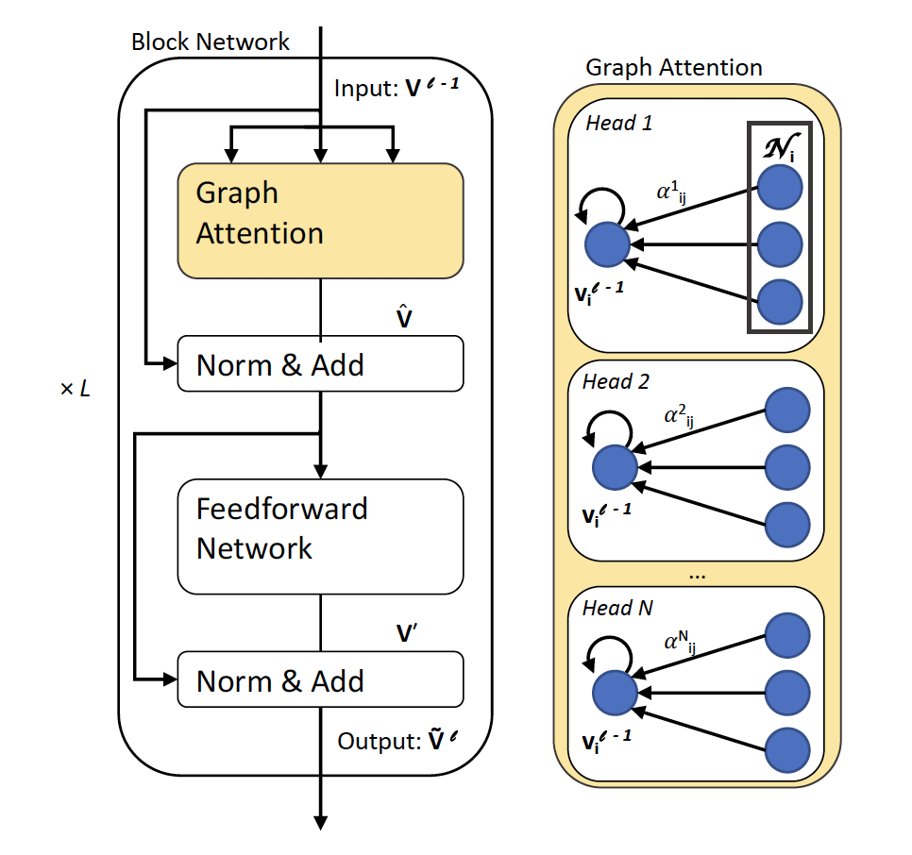
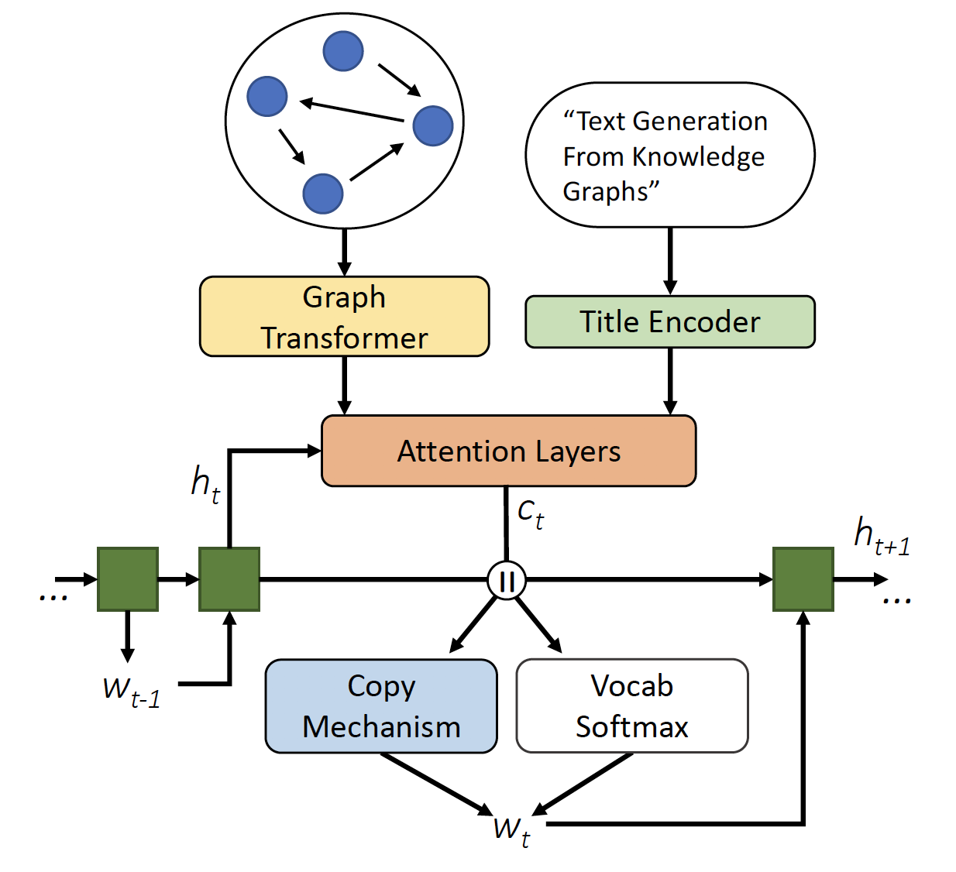
Graph in Natural Language Processing
GraphWriter
Graph Attention
Copy or vocab
DGL | Official | Speedup
1192 (s) | 1970 (s) | 1.7x
Text Generation from Knowledge Graphs with Graph Transformers

Slide 33
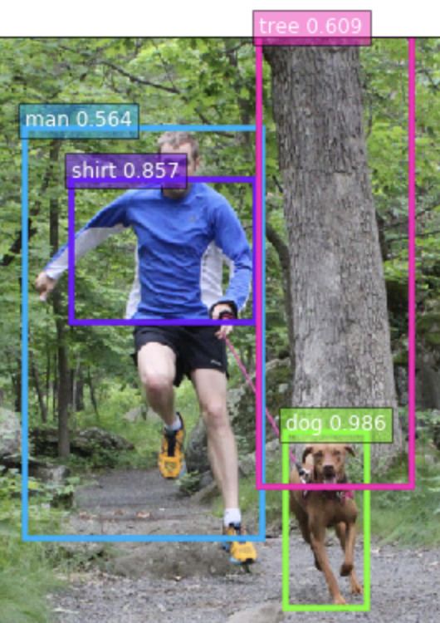
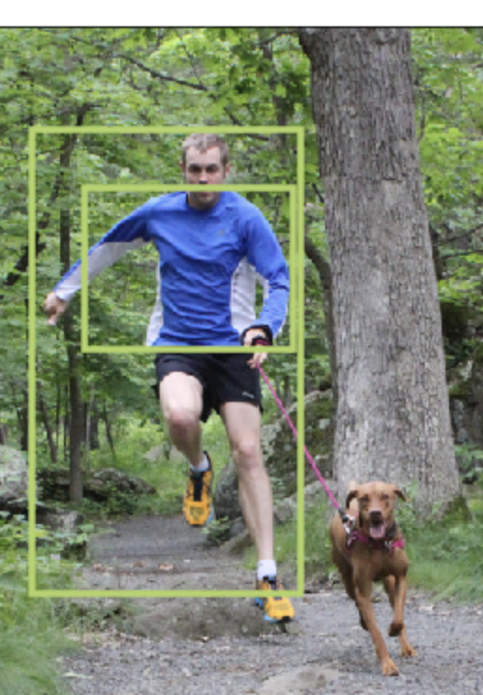
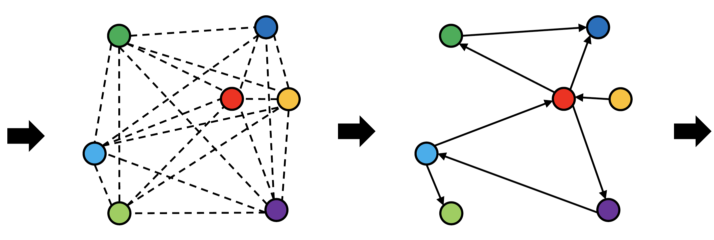
Scene graph extraction (experimental)
Graph R-CNN for Scene Graph Generation
Per epoch time 45min (vs. 2.5hr)
Link exists with prob 68.99%
Link type:
<man> <have> <shirt>, 43.29%
<man> <wear> <shirt>, 39.64%
GCN
Object Detection
Notes:
Our model can be trained in less than one hour as it converges to produce good results. This example also shows the possible ambiguity of relationships, and how the model deals with it.

Slide 34
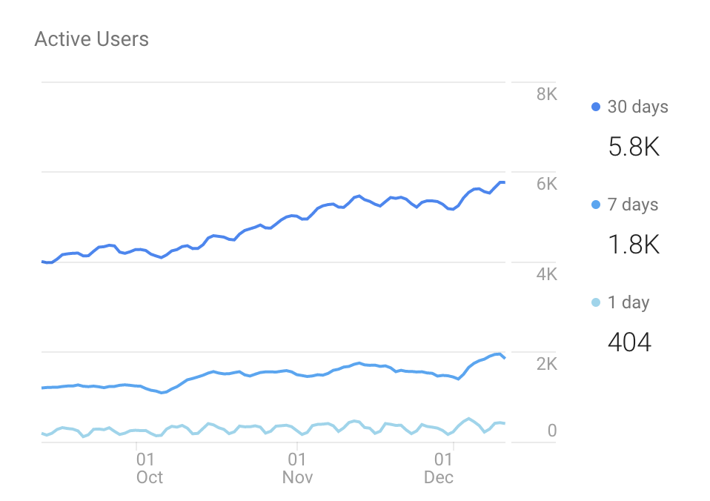
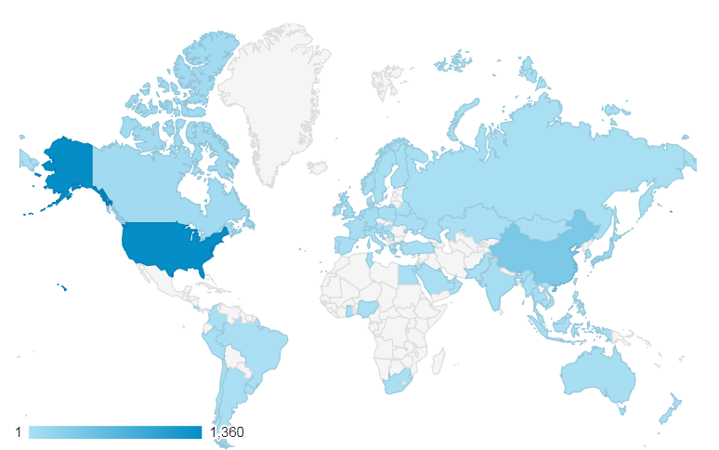
Open source, the source of innovation
3481 github stars 312k downloads for all versions on Pip 8.8K downloads for all version on Conda 1.8K anaconda downloads of 0.4.1 | 32 model examples, 28 NN modules (including 14 GNN convolution modules) 6 pretrained models for chemistry GCN, generative, KG, RecSys… 45 contributors, 10 core developers

Slide 35
DGL: next step(s)
V0.3.1
NN modules
DGL-Chem
V0.5
DGL-Rec
TF support
Distributed training
Development started
V0.2
Sampling APIs
2018
2019
2020
More model zoos
More NN modules
Faster training
…
V0.3
Fused message passing
Multi-GPU/-core
First prototype
V0.1
(NeurIPS’18)
V0.4
Heterogeneous graph
DGL-KE

Slide 36
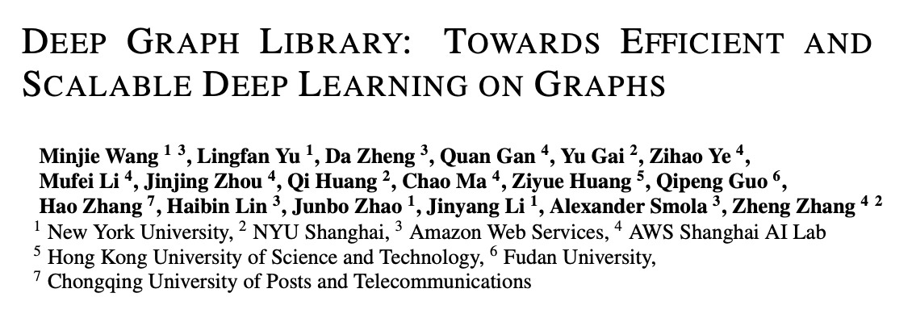
Q&A
Welcome contributions! Please cite:
Leverage
George Karypis (Univ Minnesota/AWS)
Discover
We are hiring!

